Slide 1
This is not Rockman
Software Studio 軟體設計與實驗
Hung-Kuo Chu
Department of Computer Science
National Tsing Hua University
CS2410

Slide 2
Important
We use Cocos Creator 2.2.2 in this course.
Please make sure you use the same version, otherwise your program may crash when we test it.

Slide 3
Goal
Fork repo Lab12-Rockman to your local repository.
Create “jump” animation clip and “move” animation clip, add all player’s animation clips(move, shoot, idle, reborn, jump) to player node.
Complete all TODOs written in Player.ts to create an platform game.

Slide 4
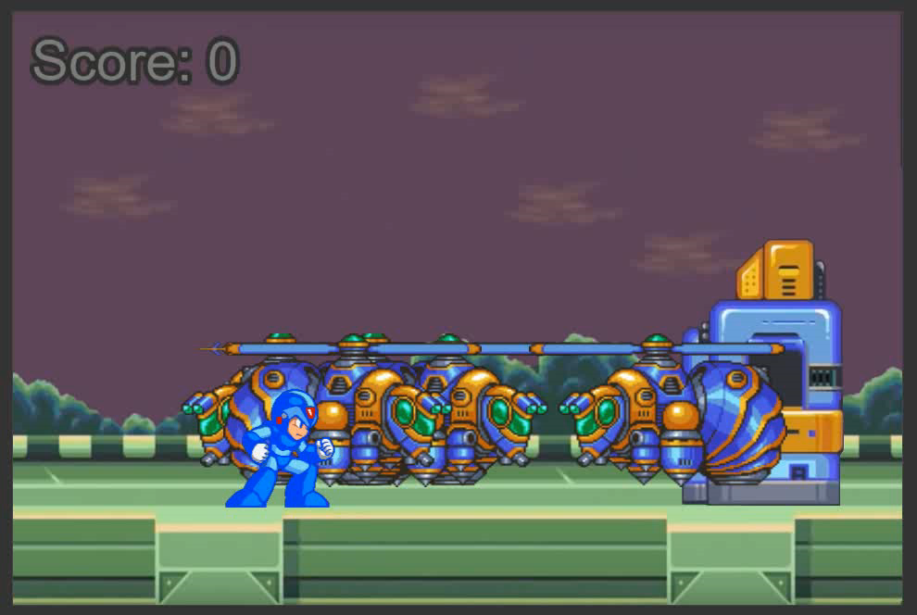
Goal (Cont'd)
Example Result
DEMO URL: https://105062302.gitlab.io/lab12-demo/

Slide 5
Goal (Cont'd)
Deadline: 2021/05/25 18:00 (FTP upload time)
Please upload your source files to FTP and name your zip file as the following name format. Otherwise you will get 0 point.
Lab12_[studentID]_v1.zip
Lab12_[studentID]_v2.zip
…

Slide 6
Grading Policy
Complete jump and move animation clips. 30%
Add all player’s animation clips to player node. 10%
Reset player’s position when the player dies. 5%
Register the callback function for reborn. 15%
Set correct linearVelocity when the player jumps. 15%
Change the animation correctly when the player falls back to the ground. 25%

Slide 7
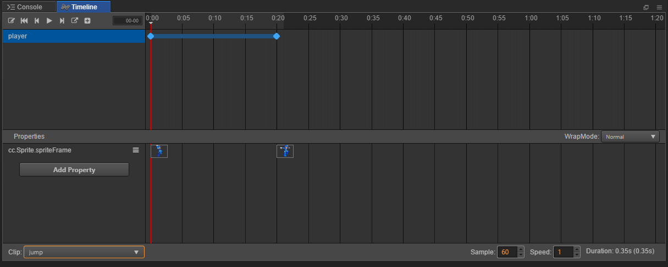
Jump Clip
Add property named spriteframe, and put atlas jump1 at time 0:00, put atlas jump2 at time 0:20.

Slide 8
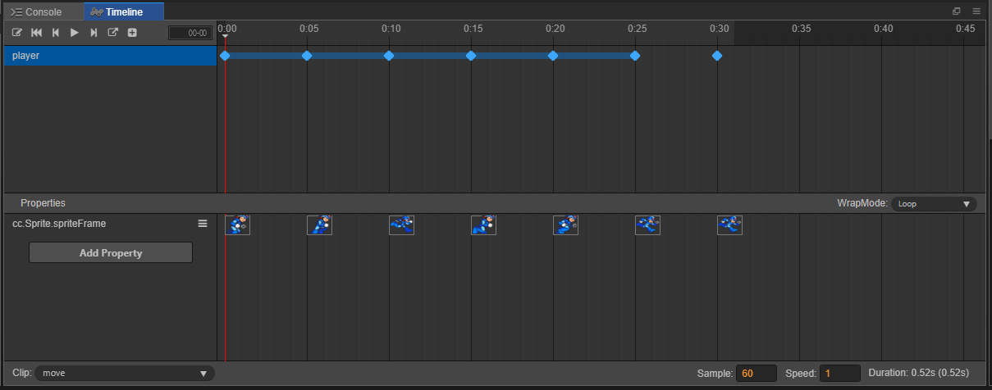
Move Clip
Add property named spriteframe, and put atlas move2 to move7 from time 0:00 to 0:30.

